Slide 1
LINDAT and TEITOK
Gold Storage and Use
Maarten Janssen
ÚFAL, Charles University, Prague

Slide 2
Course material
Colab Python notebook:
https://colab.research.google.com/drive/1sSq1Gpzbc_Ur23ERKG1V0urfrM5jnAF_?usp=sharing
TEITOK corpus:
https://quest.ms.mff.cuni.cz/teitok-dev/teitok/teaching/cls2023/index.php?action=home

Slide 3
Corpus data persistence and reuse
Corpus data in the past often disappeared
Created locally, no longer available upon change of server
Repositories
Persistent storage of data
FAIR
Findable
Accessible
Interoperable
Reusable

Slide 4
Findable
The first step in (re)using data is to find them. Metadata and data should be easy to find for both humans and computers. Machine-readable metadata are essential for automatic discovery of datasets and services, so this is an essential component of the FAIRification process.
F1. (Meta)data are assigned a globally unique and persistent identifier
F2. Data are described with rich metadata (defined by R1 below)
F3. Metadata clearly and explicitly include the identifier of the data they describe
F4. (Meta)data are registered or indexed in a searchable resource

Slide 5
Accessible
Once the user finds the required data, she/he/they need to know how they can be accessed, possibly including authentication and authorisation.
A1. (Meta)data are retrievable by their identifier using a standardised communications protocol
A1.1 The protocol is open, free, and universally implementable
A1.2 The protocol allows for an authentication and authorisation procedure, where necessary
A2. Metadata are accessible, even when the data are no longer available

Slide 6
Interoperable
The data usually need to be integrated with other data. In addition, the data need to interoperate with applications or workflows for analysis, storage, and processing.
I1. (Meta)data use a formal, accessible, shared, and broadly applicable language for knowledge representation.
I2. (Meta)data use vocabularies that follow FAIR principles
I3. (Meta)data include qualified references to other (meta)data

Slide 7
Reusable
The ultimate goal of FAIR is to optimise the reuse of data. To achieve this, metadata and data should be well-described so that they can be replicated and/or combined in different settings.
R1. (Meta)data are richly described with a plurality of accurate and relevant attributes
R1.1. (Meta)data are released with a clear and accessible data usage license
R1.2. (Meta)data are associated with detailed provenance
R1.3. (Meta)data meet domain-relevant community standards

Slide 8
Repositories
Provide an infrastructure for long-term data storage
(Semi) Commercial firms
Dropbox, Google Drive
GitHub, GitLab, Hugging Face
Can close down (copy.com, megauploads, geocities)
State-funded solutions
Zenodo (CERN, EC)
Dataverse (Harvard)
Dryad (NSF)
CLARIN ERIC
Digital infrastructure offering data, tools and services to support research based on language resources
Data endpoints / Repositories: IDS (Mannheim), TextLab (Oslo), LINDAT (Prague)

Slide 9
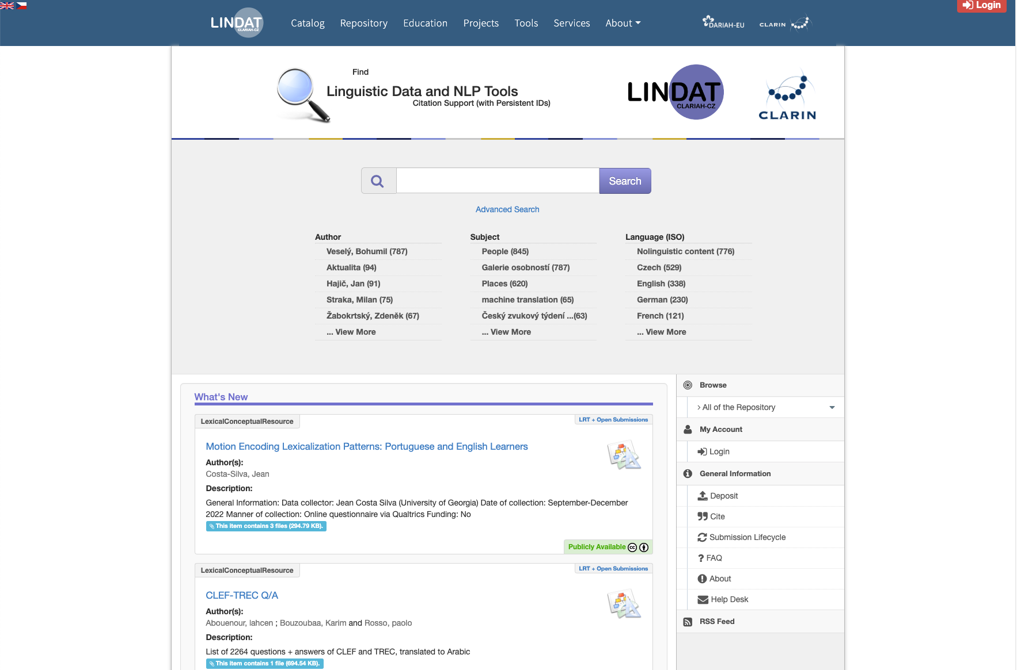
https://lindat.mff.cuni.cz/repository/xmlui/?locale-attribute=en

Slide 10
Findable
The first step in (re)using data is to find them. Metadata and data should be easy to find for both humans and computers. Machine-readable metadata are essential for automatic discovery of datasets and services, so this is an essential component of the FAIRification process.
F1. (Meta)data are assigned a globally unique and persistent identifier
F2. Data are described with rich metadata (defined by R1 below)
F3. Metadata clearly and explicitly include the identifier of the data they describe
F4. (Meta)data are registered or indexed in a searchable resource

Slide 11
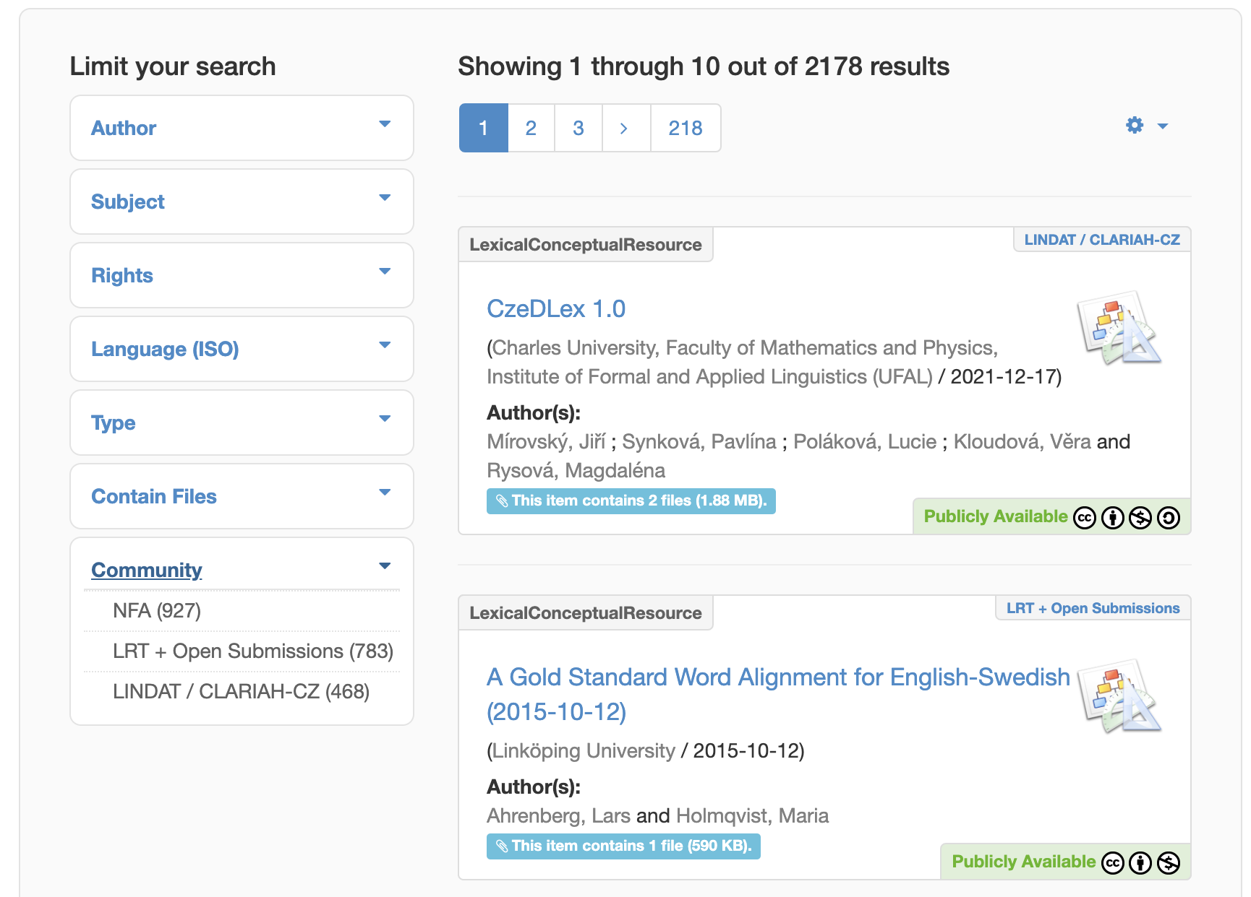

Slide 12
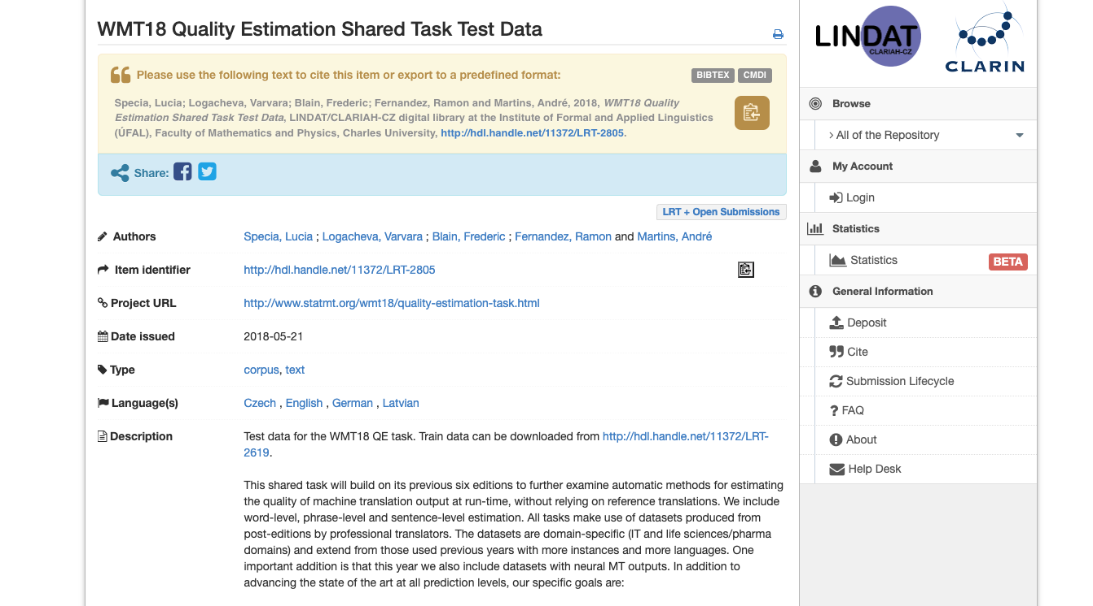

Slide 13
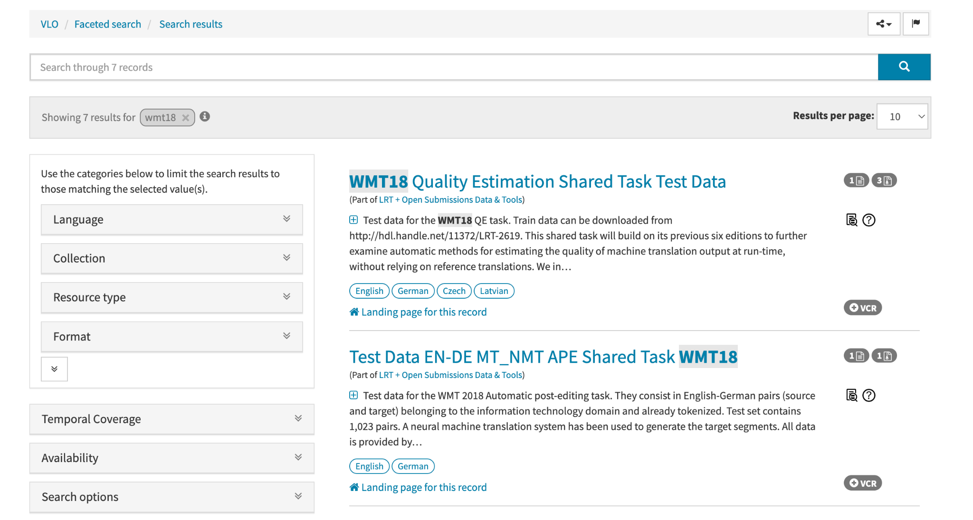

Slide 14
Accessible
Once the user finds the required data, she/he/they need to know how they can be accessed, possibly including authentication and authorisation.
A1. (Meta)data are retrievable by their identifier using a standardised communications protocol
A1.1 The protocol is open, free, and universally implementable
A1.2 The protocol allows for an authentication and authorisation procedure, where necessary
A2. Metadata are accessible, even when the data are no longer available

Slide 15
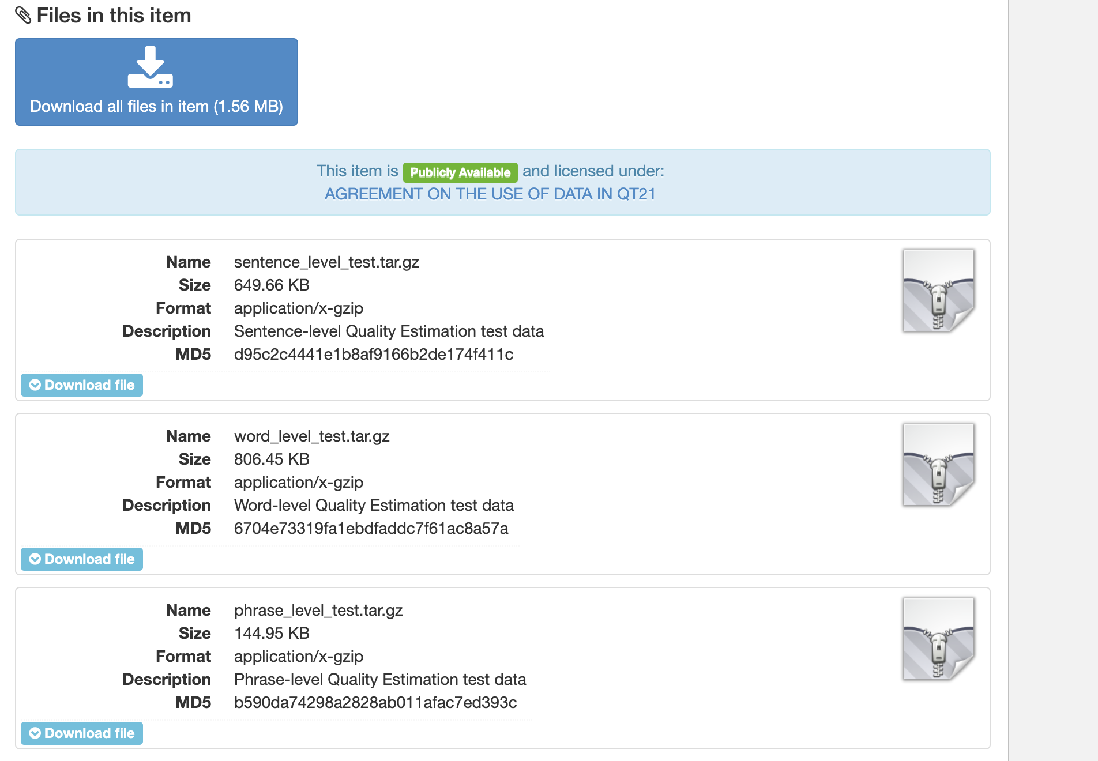

Slide 16
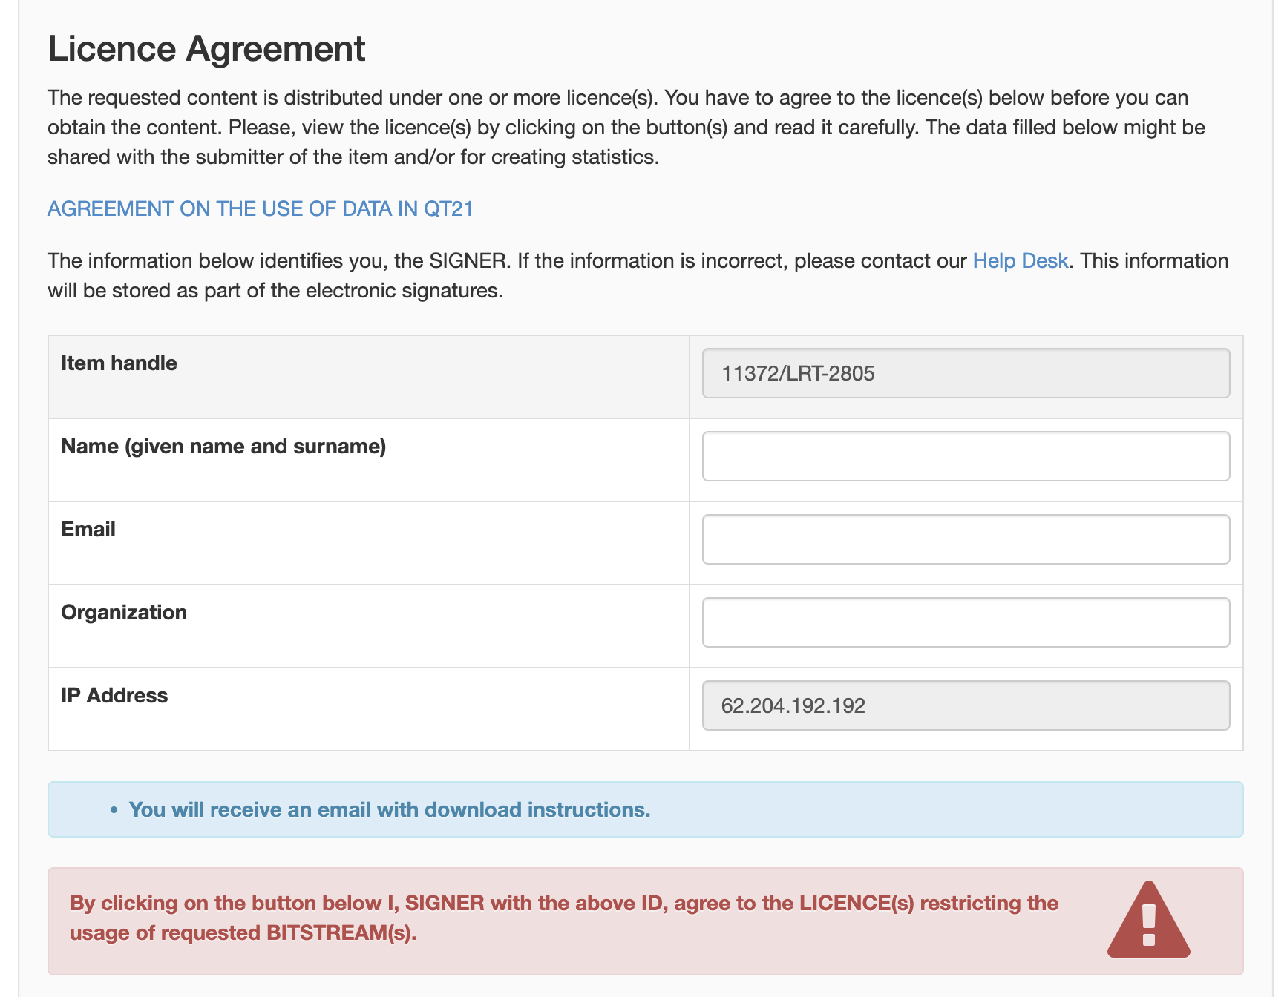

Slide 17
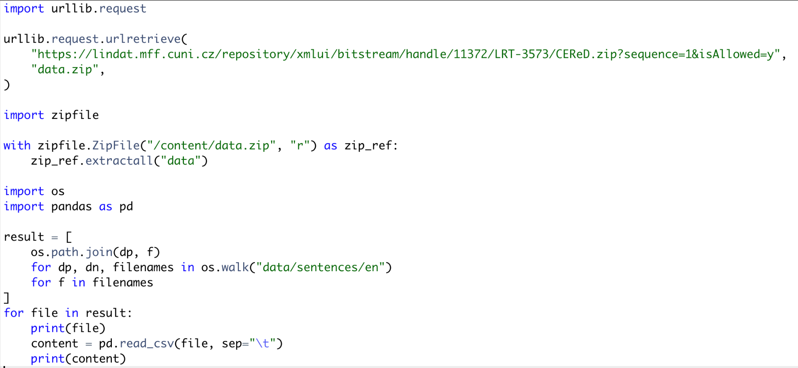
Colab demo download script

Slide 18
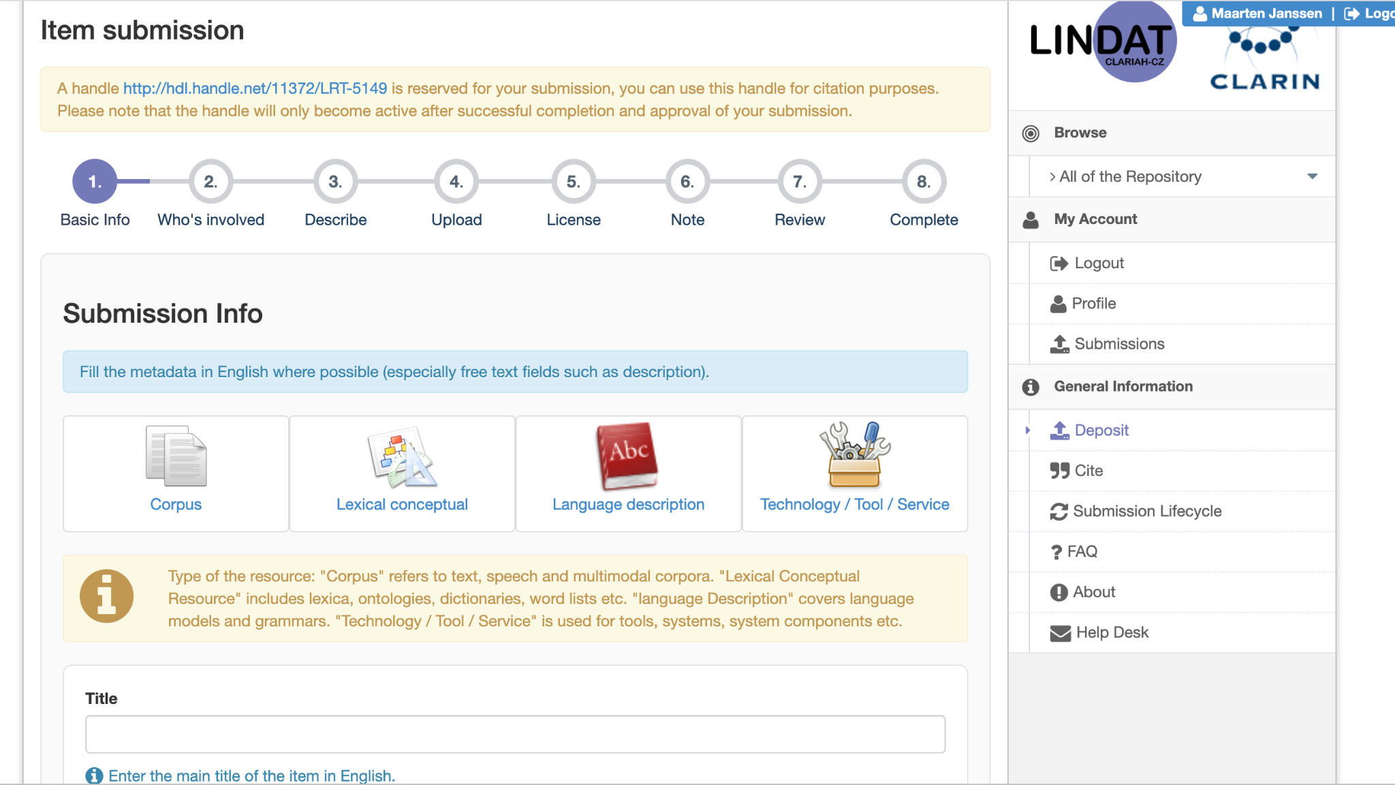

Slide 19
Interoperable
The data usually need to be integrated with other data. In addition, the data need to interoperate with applications or workflows for analysis, storage, and processing.
I1. (Meta)data use a formal, accessible, shared, and broadly applicable language for knowledge representation.
I2. (Meta)data use vocabularies that follow FAIR principles
I3. (Meta)data include qualified references to other (meta)data

Slide 20
Text Encoding Initiative
Standardized format for text documents - de facto standard in DH
XML variant (like HTML)
Document-level information
Author of the text: this text, the original it was translated from, the compiler, etc.
Date: date of publishing, first edition, original text, etc.
Recordings with date, equipment, interviewer, participants, etc.
Changes made to the document (history)
Text-level information
Paragraphs, chapters, sections, columns, etc.
Bold, change of hand, unclear, added later, dropcaps, gaps, etc.
Time index for spoken text, text region for transcribed manuscripts, etc.
Names of people, events, places, terms, etc.

Slide 21
<TEI>
<teiHeader>
(all document-level information)
</teiHeader>
<text>
(the text with all text-level information)
</text>
</TEI>

Slide 22
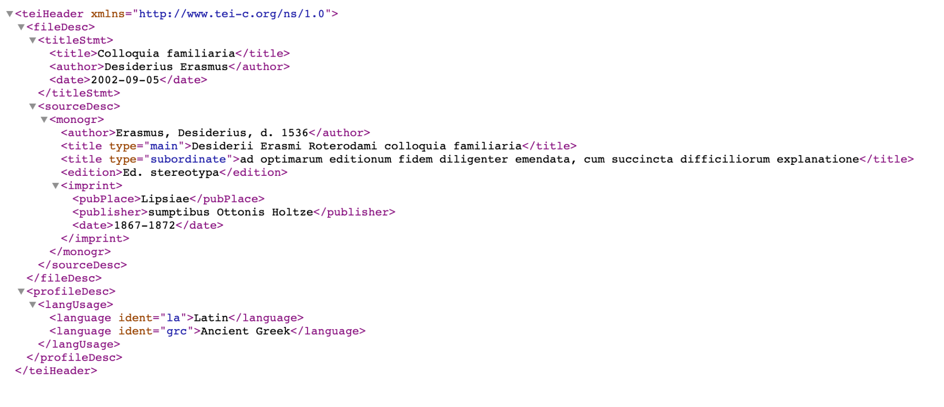

Slide 23
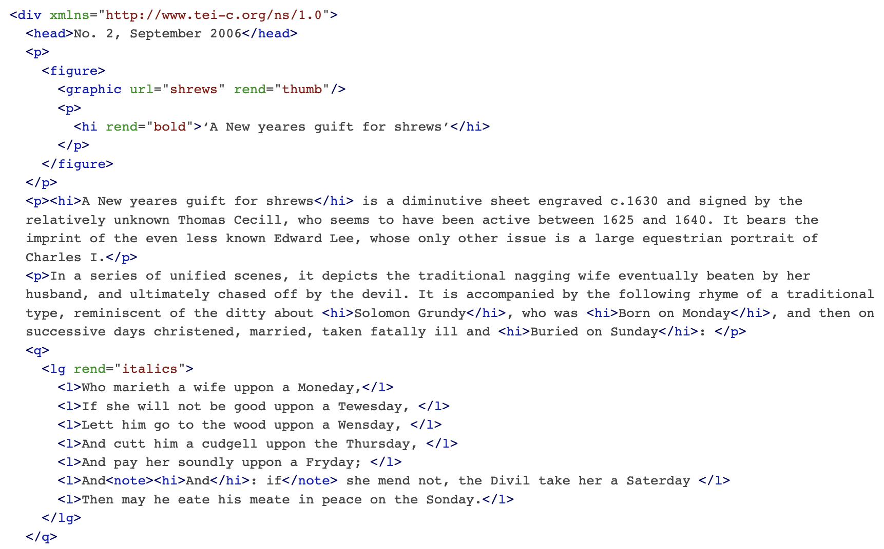

Slide 24
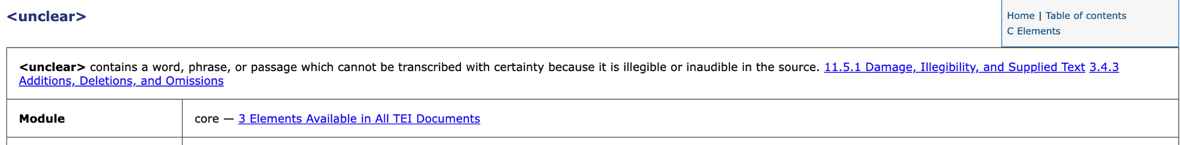
TEI Standardization
Purposefully soft standard
Many solutions for the same problem
Versatile and widely used
What is there is well-defined

Slide 25
Reusable
The ultimate goal of FAIR is to optimise the reuse of data. To achieve this, metadata and data should be well-described so that they can be replicated and/or combined in different settings.
R1. (Meta)data are richly described with a plurality of accurate and relevant attributes
R1.1. (Meta)data are released with a clear and accessible data usage license
R1.2. (Meta)data are associated with detailed provenance
R1.3. (Meta)data meet domain-relevant community standards

Slide 26
Reuse corpus data
Create a new corpus by using/combining existing ones
Search and download data
Harmonize data
Easy if everything is TEI or convertible to it
Exploit for new research

Slide 27
Enrich repository data
Download repository data
Make sure licence is adequate
Best to use static data
Enrich the data
Annotate named entities
Provide network graph
Normalize the orthography
Deposit enriched data
Give others access to your enrichments
Licence cannot be more liberal than original

Slide 28
Directly Accessible
Once the user finds the required data, she/he/they need to know how they can be accessed, using an easy to use interface language.
Ideally, the data access point should directly allow novel research on the data without the need establish a new corpus out of it.

Slide 29
Advanced Programming Interfaces
Access data using a program (Python script) - from Dracor:
import urllib.request, json, os, sys
start_url = "https://dracor.org/api/corpora/shake"
with urllib.request.urlopen(start_url) as url:
dramas = json.load(url)
if not os.path.exists("shake"):
os.mkdir("shake")
for drama in dramas['dramas']:
dramaname = drama['name']
print("DRAMA: " + dramaname)
text_url = start_url + "/play/" + dramaname + "/spoken-text"
text_file = "shake/" + dramaname + ".txt"
urllib.request.urlretrieve(text_url, text_file)
f = open(text_file)
data = f.read()
print(data)

Slide 30
Online Query Interfaces
Corpus WorkBench (offline)
Corpus Query Language
Sequences of words by features
[word=”the”] [pos=”ADJ”]{2,} [pos=”NOUN”]
Various online tools using CWB
CQPweb, Korp, BwanaNet, TEITOK
Various other tools implementing CQL
SketchEngine, KonText (Manatee), BlackLab (Lucene), etc.
Small variations in advanced query functions
Various related languages based on CQL
Using brackets for tokens with attribute-value pairs inside
PML-TQ - tree querying

Slide 31
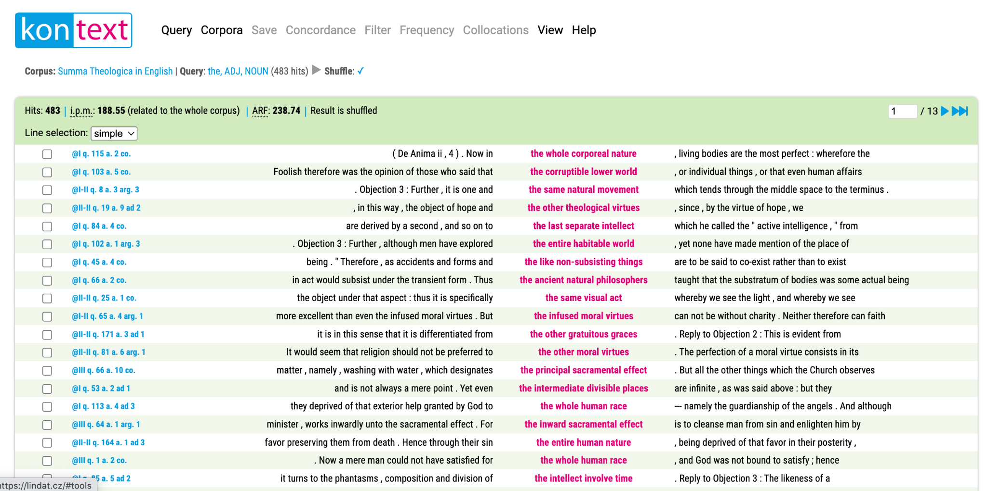
https://lindat.mff.cuni.cz/services/kontext/first_form?corpname=summa_en_a

Slide 32
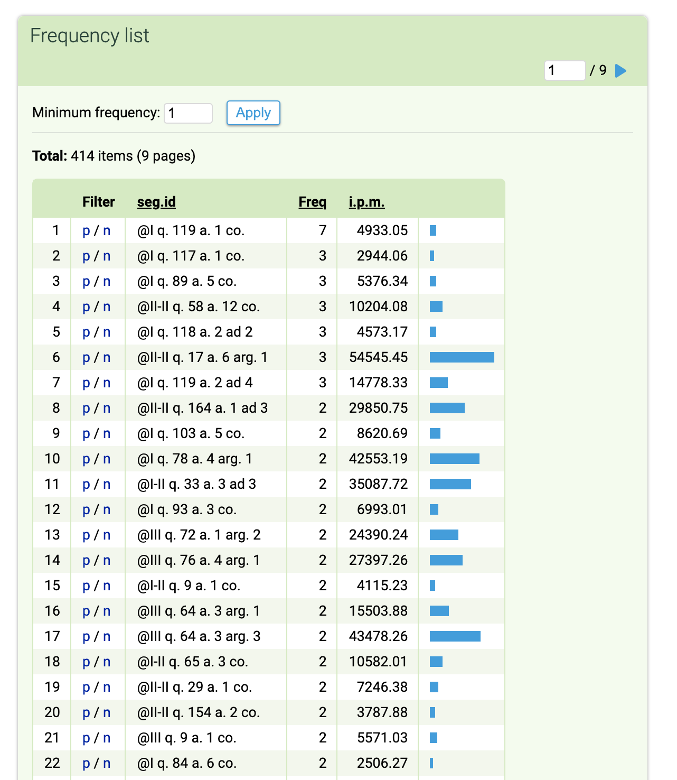

Slide 33
TEITOK
Online environment for developing corpora and making them available
Fully TEI based
Sticking to TEI standard where possible
All annotating done directly over TEI files
Multipurpose
Serving as wide a range of TEI documents as possible
Used at LINDAT to make corpora directly accessible
Providing inline information wherever possible, minimizing the need to read documentation
Provides an API
Download data
Query data
Annotate data

Slide 34
TEITOK
Create a project
On your local installation (server, although Docker is possible)
Hosted somewhere where TEITOK is installed (Prague, Granada, Alcala, Barcelona, Coimbra)
Upload TEI documents to the project
Or upload other files that will be converted (from a limited list of formats)
XML files automatically indexed
CQP (or other) searchable corpus automatically generated from XML files
Maintain and edit XML files
Or merely create as converted data

Slide 35
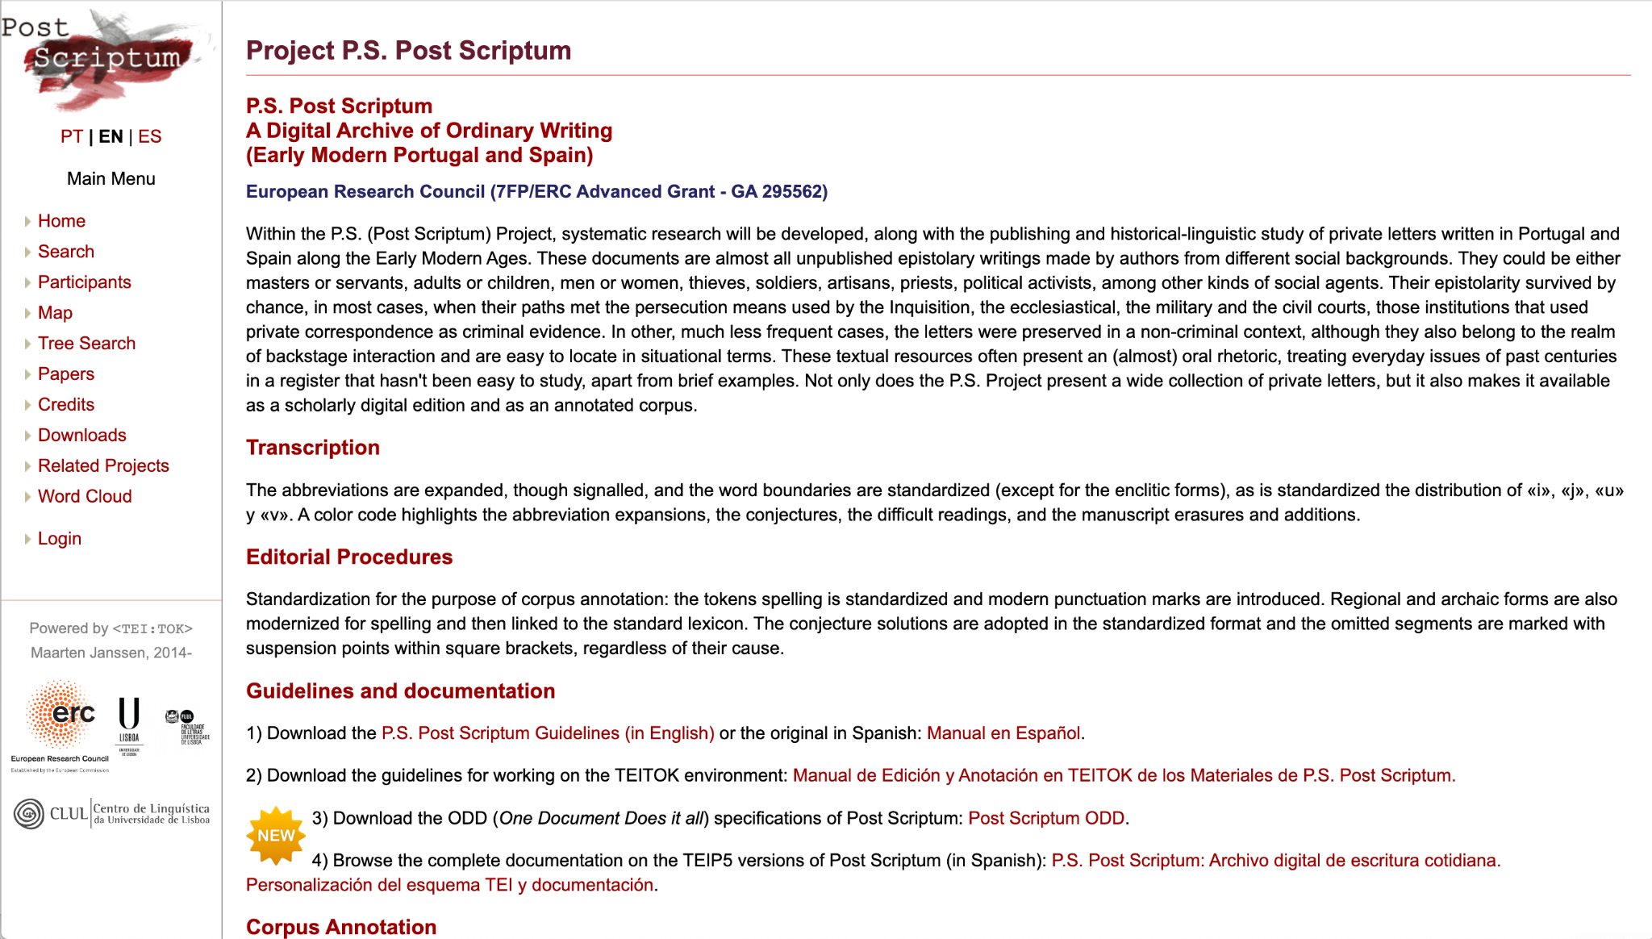

Slide 36
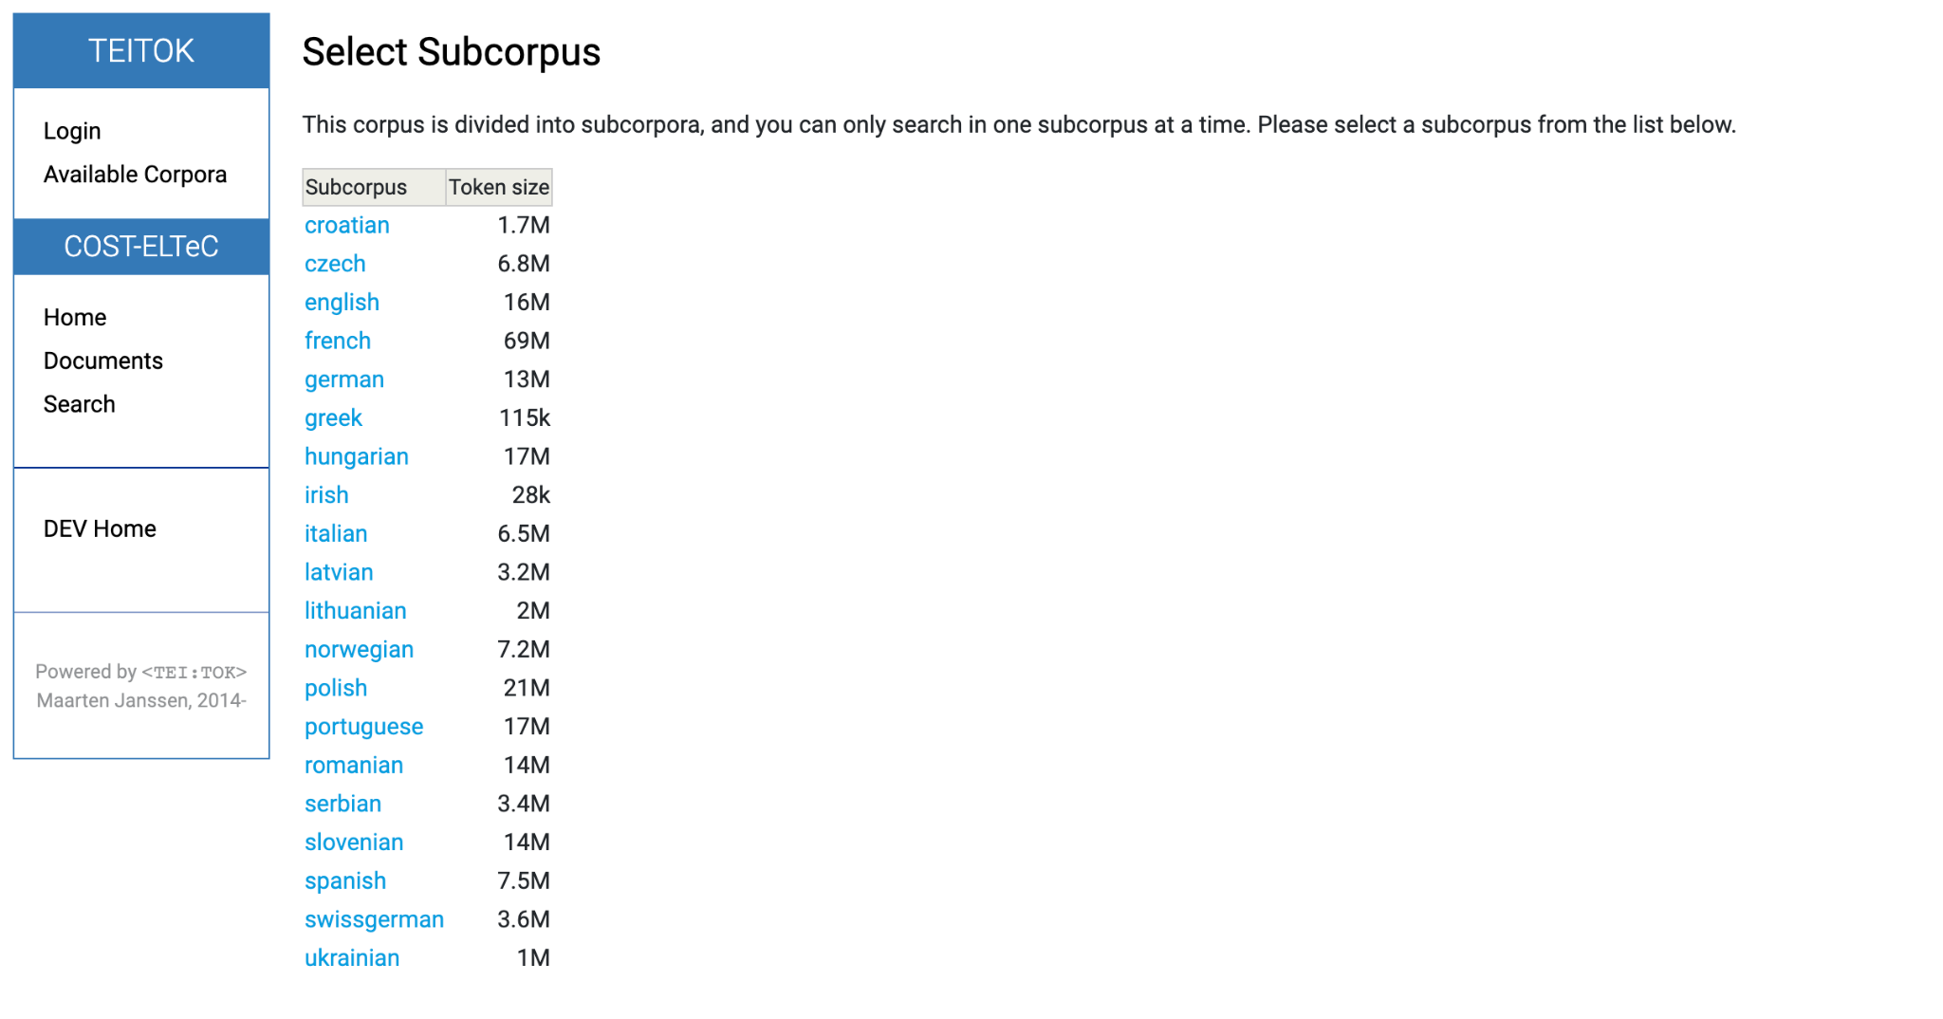

Slide 37
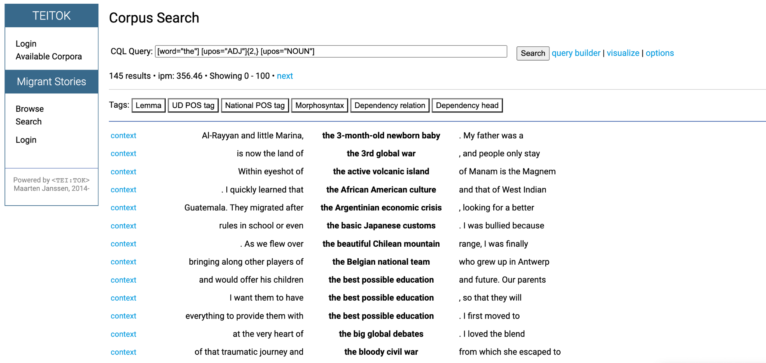
https://lindat.mff.cuni.cz/services/teitok-live/migrantstories/index.php?action=cqp

Slide 38
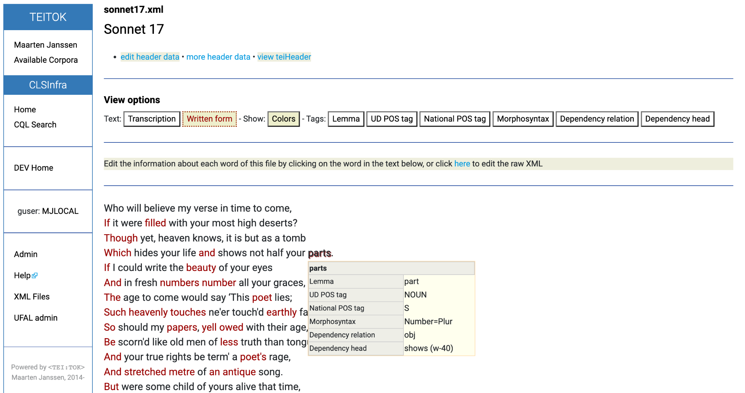

Slide 39
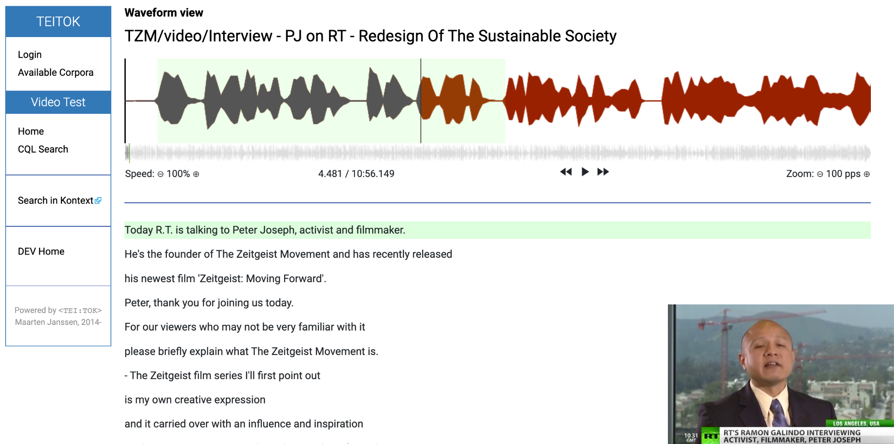

Slide 40
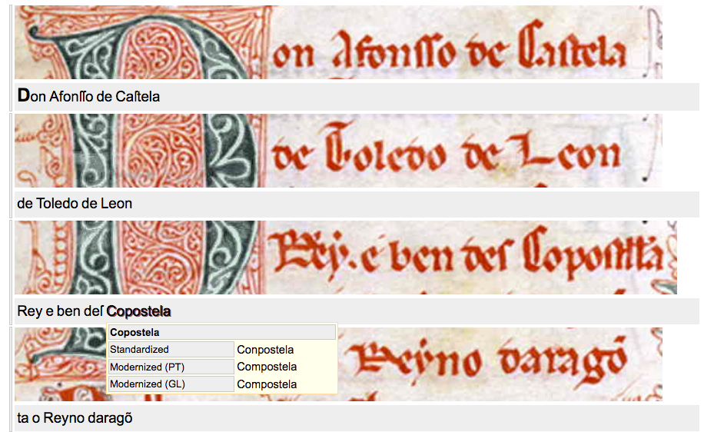

Slide 41
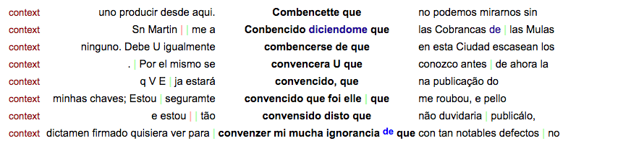
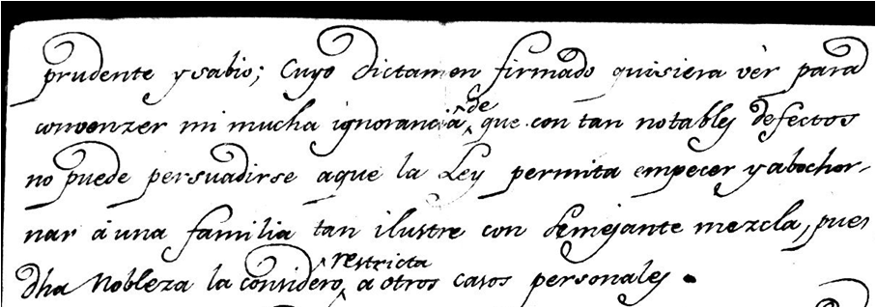
Importance of access to source

Slide 42
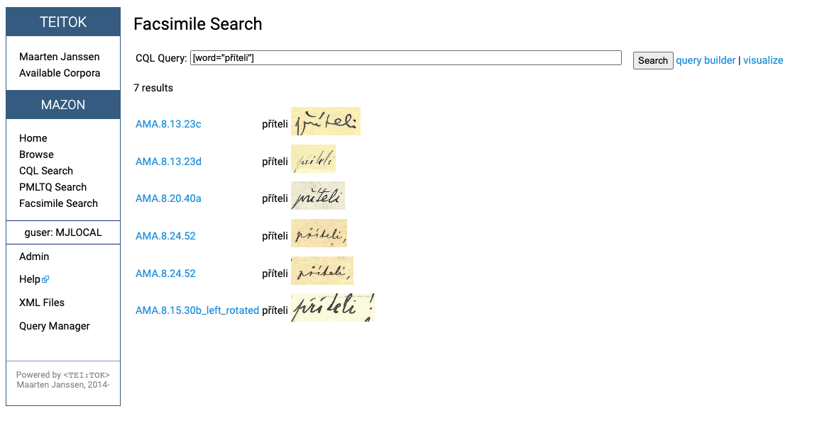

Slide 43
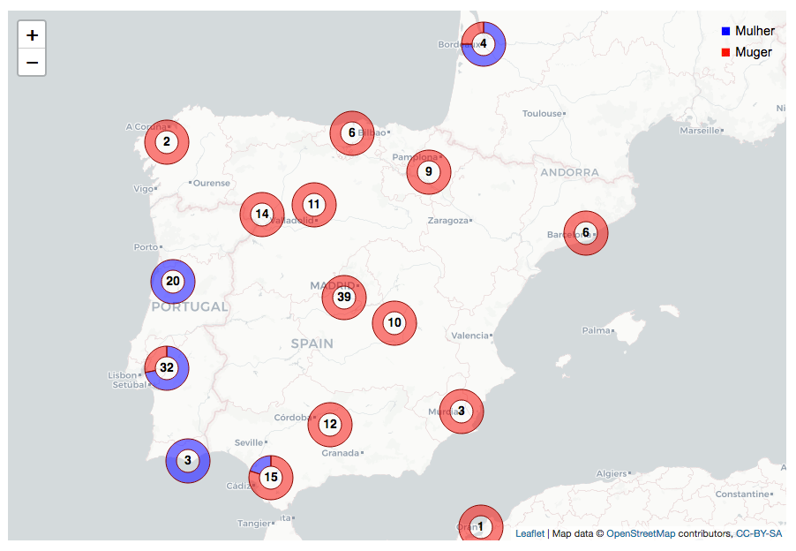

Slide 44
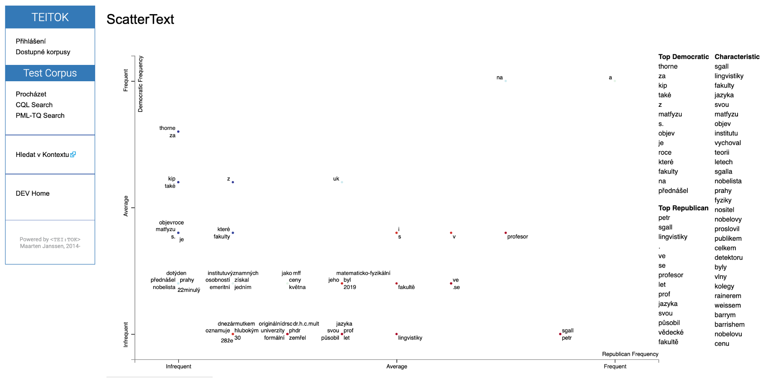

Slide 45
Editing XML files
TEITOK not only allow searching, but also editing
Edit metadata in simple HTML forms
Define beforehand which metadata are relevant in the corpus
Defined as “Python dictionary” with XPath as key
System will place data in its correct place in the XML
Tokenize automatically
Create token nodes around all words in the document
Annotate automatically
Run NLP pipelines with a click (UDPipe)
Run other tools (SpaCy, CLASSLA) using the API
Correct manually
Click on a word and manually correct it

Slide 46
Text normalization
Old and LRL text often without spelling norm
Original spelling often important
Non-destructive normalization
Contradictory statements
Orthographic variation does (not) impact stylometry
People bad at statistical intuition
… cuando la rueda se desinfla …
There will always be cases where normalization helps

Slide 47
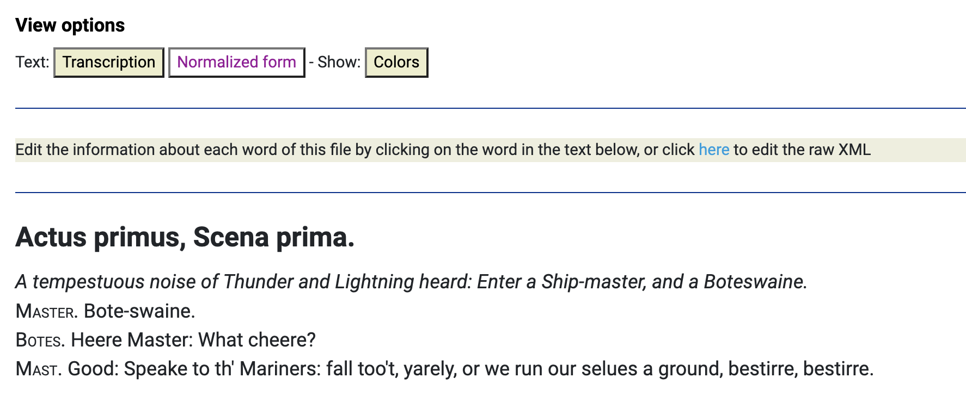
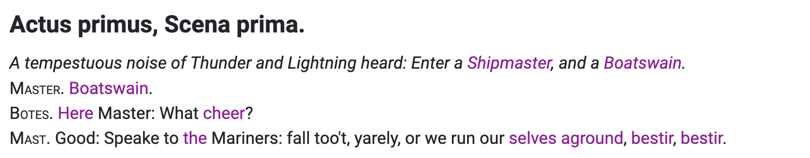
https://quest.ms.mff.cuni.cz/teitok-dev/teitok/teaching/cls2023/index.php?action=file&id=tempest_1_15.xml

Slide 48
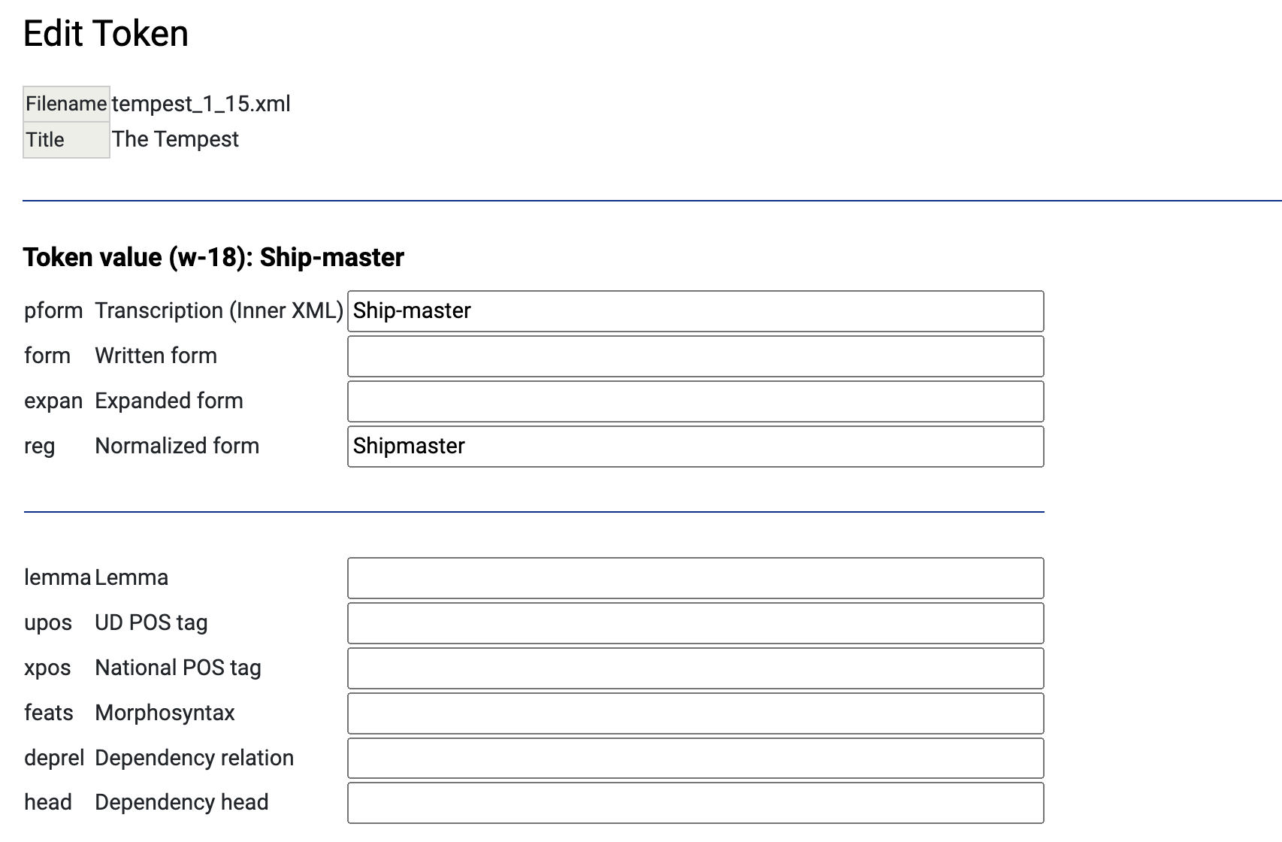

Slide 49
